Slide 1
Distributed Systems Projects
Chapter 2. Models and clocks (1)
27/09/2024

Slide 2
Today’s agenda:
Network Time Protocol (NTP)
Distributed system events
Happens-before (Causality) model
Logical clocks
Lamport clock

Slide 3
Network Time Protocol (NTP)
The Network Time Protocol (NTP) is a protocol used to synchronize the clocks of computers and devices across a network to a precise reference time.
One the oldest internet protocols that are still in use. Designed by David L. Mills. It was first conceived in 1985 NTPv0 - RFC 958 → 2010 NTPv4 - RFC 5905.
Ensures that systems have consistent and accurate time, which is critical for event ordering, logging, and system coordination.

Slide 4
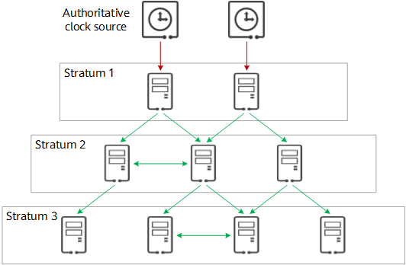
Network Time Protocol (NTP)
NTP uses a hierarchical system of time sources, organized into levels known as stratum – 16 levels in total:
Stratum 0: Reference clocks (e.g., atomic clocks, GPS clocks).
Stratum 1: NTP servers directly connected to Stratum 0 devices.
Stratum 2 and below: Devices synchronized from Stratum 1 or other higher stratum servers.
Client-Server Model: NTP clients request the current time from NTP servers, which respond with a timestamp to adjust the client’s clock.​

Slide 5
Network Time Protocol (NTP)
NTP is levelled as a hierarchy to handle scale. Millions of devices connect to NTP servers to adjust time. It is not feasible to let all of them connect to the same NTP source.
Any device, would query multiple time servers at different levels and chooses the best on to adjust time.
NTP can synchronize time to within milliseconds over the internet and microseconds on local networks, providing high accuracy.
Most big corporations manage their own NTP time servers:
Cloudflare
Meta
Google
Cool project to contribute to: https://www.ntppool.org/en/​

Slide 6
Why do we care about time?
Cool...
But Distributed Systems do not have a shared global clock.
It is not possible to compare timestamps across machines...

Slide 7
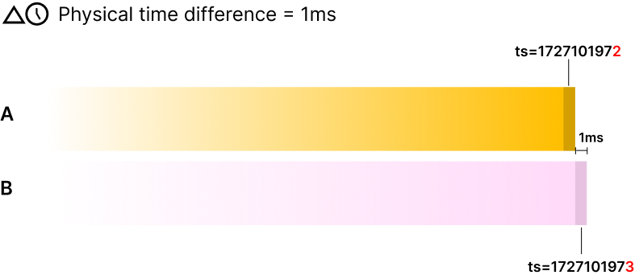
Why do we care about time?
Suppose two nodes with a physical time diff of 1ms.
The first node runs a transaction X.
The second node runs a transaction Y.
The events are logged, and we get the following transactions:
X happened at ts=1727101972
Y happened at ts=1727101973 (X's ts + 1)

Slide 8
Why do we care about time?
These appear to be sequential, even though they are concurrent
In this example, we lose the notion of currency.
Similarly, if two transaction are not supposed to be concurrent, they may appear concurrent because of timestamp difference.
This could lead to problem and headaches when tracing bugs and troubleshooting systems.

Slide 9
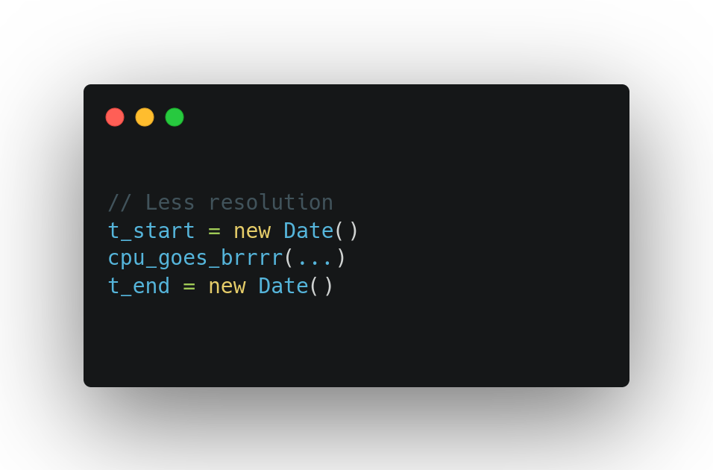
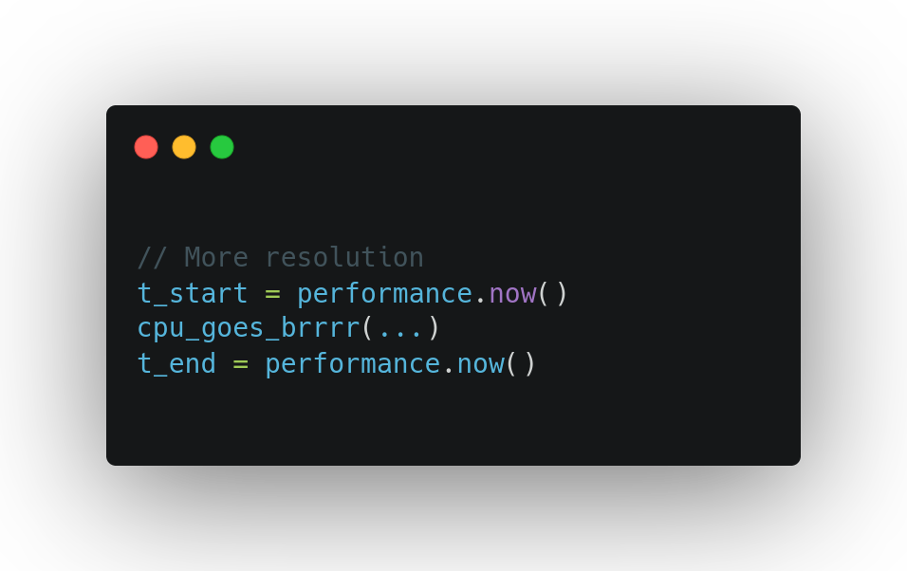
Let’s talk about time and its importance
Wall clocks (real time) vs Monotonic clocks

Slide 10



The need of events ordering
2
1

Slide 11
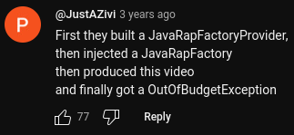
The need of events ordering
By the way, "Java Life" is an official Oracle song and the following comment in the YouTube section is hilarious.
Please check the video after the lecture.

Slide 12
Distributed system events
We need to characterize our distributed program:
Local events: Events that happen in a node and changes its state.
Sending events: A certain node sends a message to another node to inform about a change.
Reception events: A node receives a message from another one about a change.
It does not completely characterize its behavior. We need an ordering relation!

Slide 13
Happens-before model
The relation is transitive
The relation is irreflexive – an event cannot precede itself
The relation is asymmetric

Slide 14
Happens-before model
Two distinct events a and b are concurrent if:

Slide 15
Logical clocks
The purpose of a clock is only to give us a notion of order between events (do not confuse with any other property associated with clocks such as elapsed time between two events).
Recall that we only have two kinds of information to determine order:
The order of events on a single process
The order between the sending and reception events of a message
Formal definition of a logical clock: A logical clock must satisfy the following constraint:

Slide 16
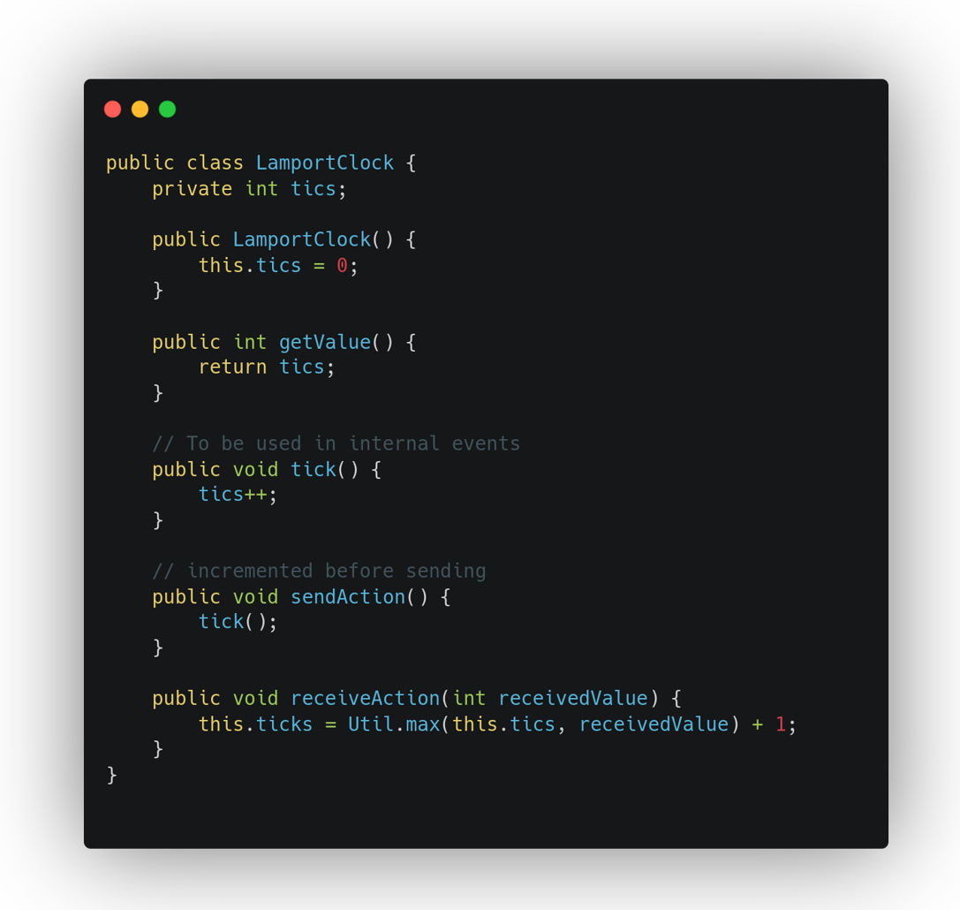
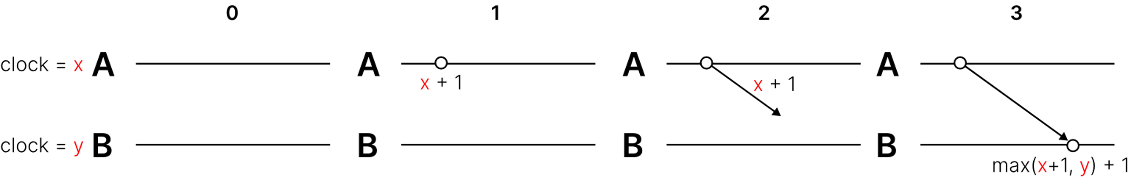
Logical clocks: Steps of Lamport clock
Before event execution, a process increments its own logical clock t(x)
The sender process sets the message’s timestamp to the new value.
When message is received by the receiver, the receiver sets its counter to max(sender clock, local clock) + (one tick).

Slide 17
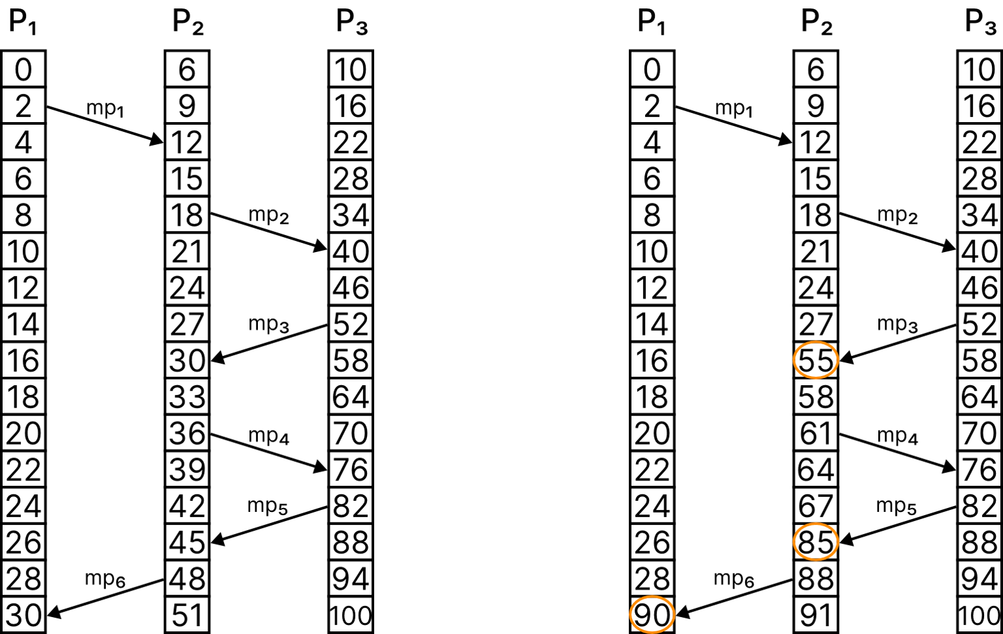
Logical clocks: Lamport clock
Circled slots are when clocks are adjusted to attain happens-before relation

Slide 18
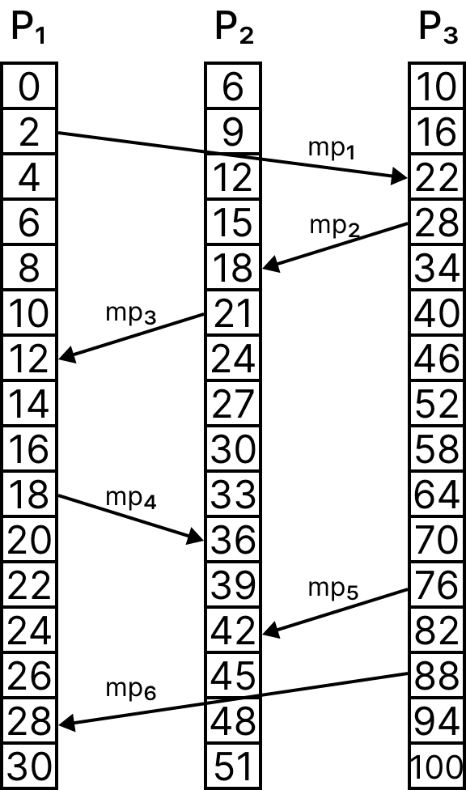
Logical clocks: Lamport clock exercise 1
Cluster of three nodes {P₁, P₂, P₃}
P1 monotonic clock increases @ 2 units
P2 monotonic clock increases @ 3 units
P3 monotonic clock increases @ 6 units

Slide 19
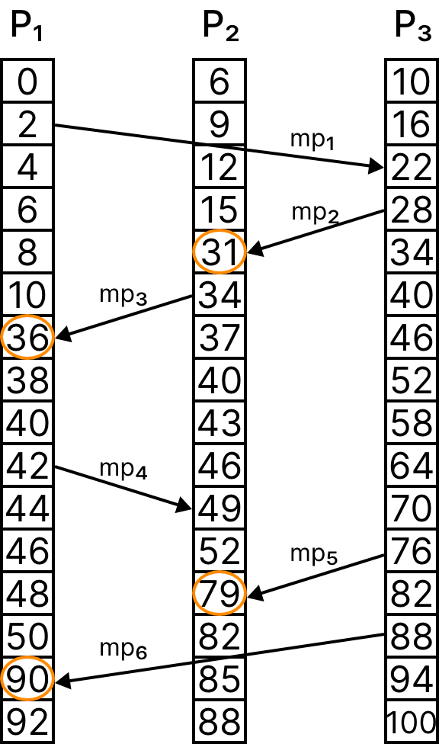
Logical clocks: Lamport clock solution 1
Cluster of three nodes {P₁, P₂, P₃}
P1 monotonic clock increases @ 2 units
P2 monotonic clock increases @ 3 units
P3 monotonic clock increases @ 6 units

Slide 20
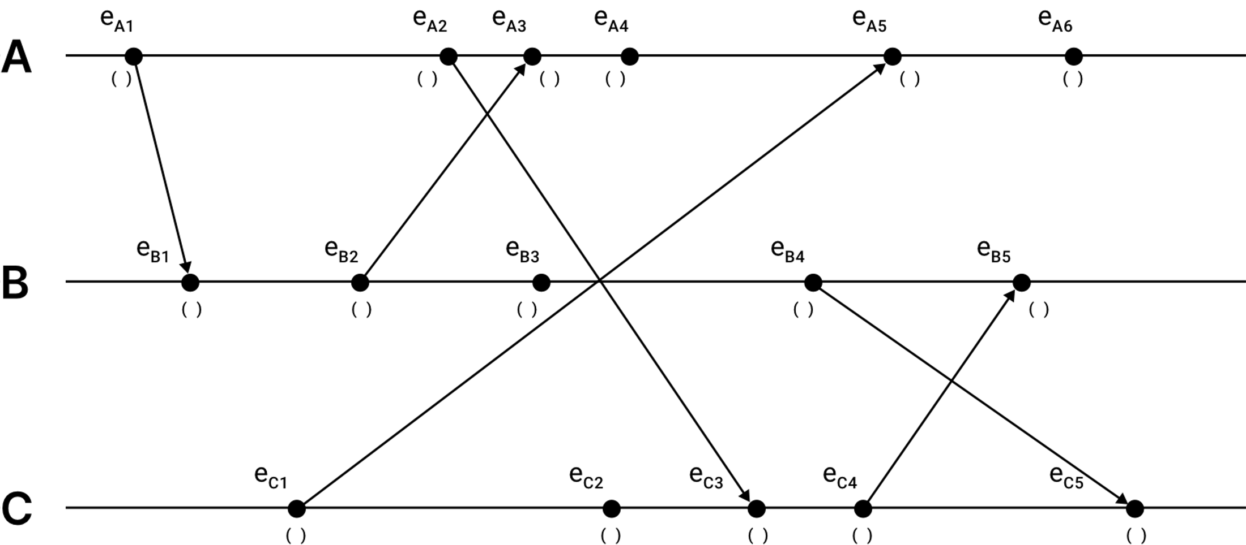
Logical clocks: Lamport clock exercise 2
All clocks start at ts=0

Slide 21
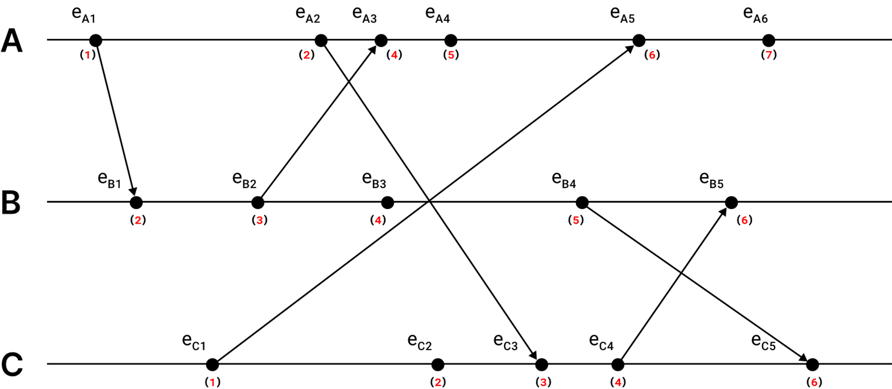
Logical clocks: Lamport clock solution 2
All clocks start at ts=0

Slide 22
Recommended references
Network Time Protocol Rev3 RFC 1305
https://www.rfc-editor.org/rfc/rfc1305.pdf
Time, clocks, and the ordering of events in a Distributed System
https://lamport.azurewebsites.net/pubs/time-clocks.pdf

